Slide 1
Multinomial Mixed-Effects Models
and Linguistic Variation:
Competitions among Japanese
Subject-Honorific Constructions
Akitaka Yamada
JADH 2020
Nov. 23 (Osaka University, presented online)

Slide 2





1 Introduction
Topic: Linguistic variation
How are synonymous expressions distinguished in use?
cf. Weinlich et al. (1968): Orderly Heterogeneous
Japanese subject-honorifics
Instance１
$$\text{go}\text{−}√\text{+}\text{ni} \text{nar}\text{−}$$
Factor 1
Instance 2
$√$+nasar-
Factor 2
Instance 3
go-$√$+nasar-
…
Instance 4
$√$+s-are-
Factor 3
Instance 5
$\text{go}\text{−}√$+s-are-
Factor 4

Slide 3
1 Introduction
Topic: Linguistic variation
How are synonymous expressions distinguished in use?
cf. Weinlich et al. (1968): Orderly Heterogeneous
Japanese subject-honorifics
Sentence-level factors
Instance１
$$\text{go}\text{−}√\text{+}\text{ni} \text{nar}\text{−}$$
Factor 1
sentence-mood
(Yamada 2019)
Instance 2
$√$+nasar-
Factor 2
Instance 3
go-$√$+nasar-
…
Verb-level factors
Instance 4
$√$+s-are-
Factor 3
mora
Instance 5
$\text{go}\text{−}√$+s-are-
Factor 4
origin
(Kikuchi 1997)

Slide 4
2 Data, Model and Estimation

Slide 5

2 Data, Model, and Estimation
Outline
Data
Data BCCWJ
Token 20, 864 hits
Type 1, 617 verbs
Removing unexpected instances
toki ‘time’
oboe-toki-nasai-yone. (覚え とき なさい よ ね)”
remember-prepare-HONS-SFP
`Don’t forget (Remember) what you did!’
"馴染み","馳走","世話","参考", "天気","正月","荷物","機嫌",
"菓子", "金", "金持ち", "手本", "昼", "得", "破算", "友達", "厄介",
"免", "力", "時"
Screening verbs by frequency
$$≥24 times$$
Token 11, 233 hits
Type 95 verbs

Slide 6
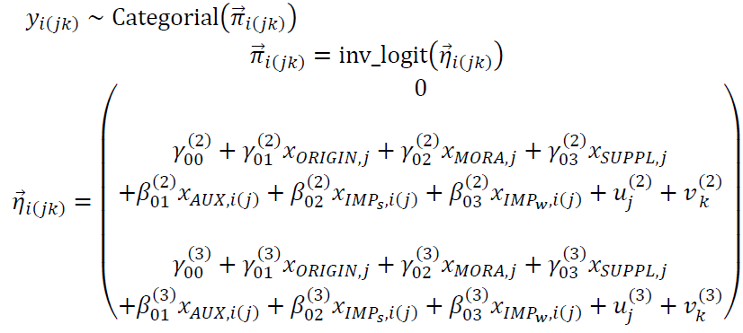
2 Data, Model, and Estimation
Outline
Data
Model
Multinomial Mixed-Effects Models

Slide 7



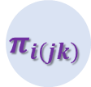













2 Data, Model, and Estimation
Outline
Data
Model
Outcome variable
$$π_{i\left(jk\right)}$$
$$η_{i\left(jk\right)}$$
$$y_{i\left(jk\right)}$$
$$iid \sim Categorial$$
$$=inv_logit\left( \right)$$
Predictors
$$β_{1}$$
(aux)
Population-level
(Level 1)
Factors
$$η_{i\left(jk\right)}$$
$$β_{2}$$
(imp_s)
$$β_{3}$$
(imp_w)
$$β_{0j}$$
$$γ_{1}$$
(origin)
Group-level
(Level 2)
Factors
$$γ_{2}$$
(mora)
$$γ_{0}$$
$$γ_{3}$$
(suppl)
(intercept)
$$u_{j}$$
(lexeme)
$$β_{0k}$$
$$v_{j}$$
(register)

Slide 8
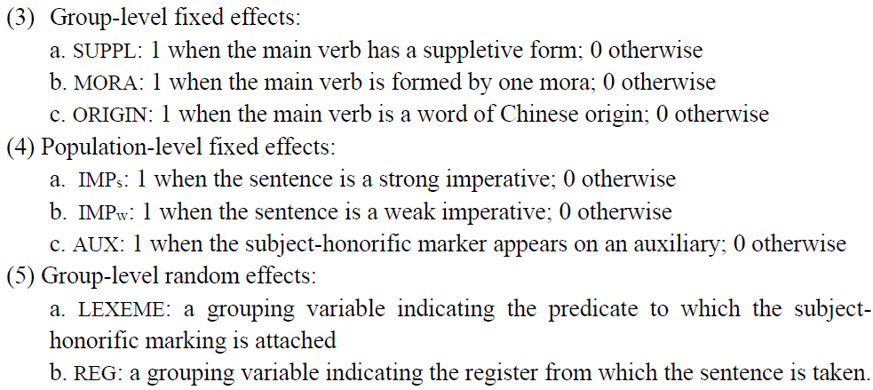
2 Data, Model, and Estimation
Outline
Data
Model
Factors

Slide 9
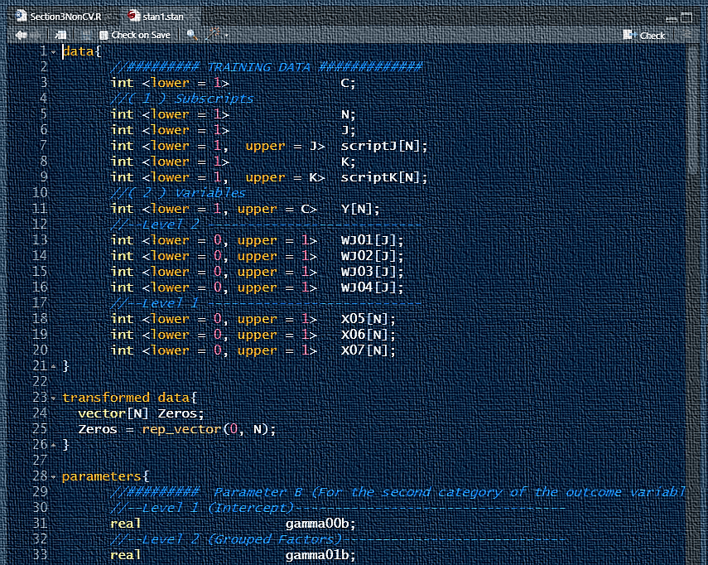
2 Data, Model, and Estimation
Outline
Data
Model
Estimation
Stan
R/python
Stan
C++
R/python

Slide 10
3 Results

Slide 11
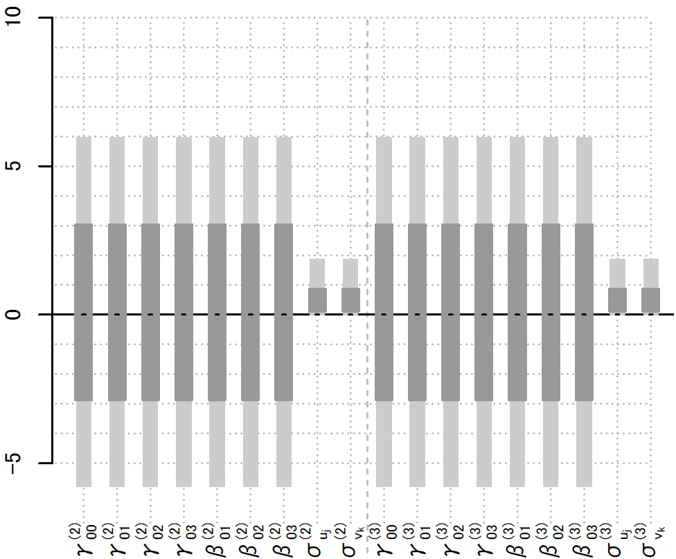












3 Results
Outline
Priors
Priors
(2) vs. nasar- (3) vs. o-…nasar-
$$β_{1}$$
(aux)
$$β_{2}$$
N(0,3)
Half-t4(0,0.5)
(imp_s)
$$η_{i\left(jk\right)}$$
$$β_{2}$$
(imp_w)
$$β_{0j}$$
$$γ_{1}$$
(origin)
$$γ_{2}$$
(mora)
$$γ_{0}$$
$$γ_{3}$$
(suppl)
(intercept)
$$u_{j}$$
(lexeme)
$$β_{0k}$$
$$v_{j}$$
(register)

Slide 12
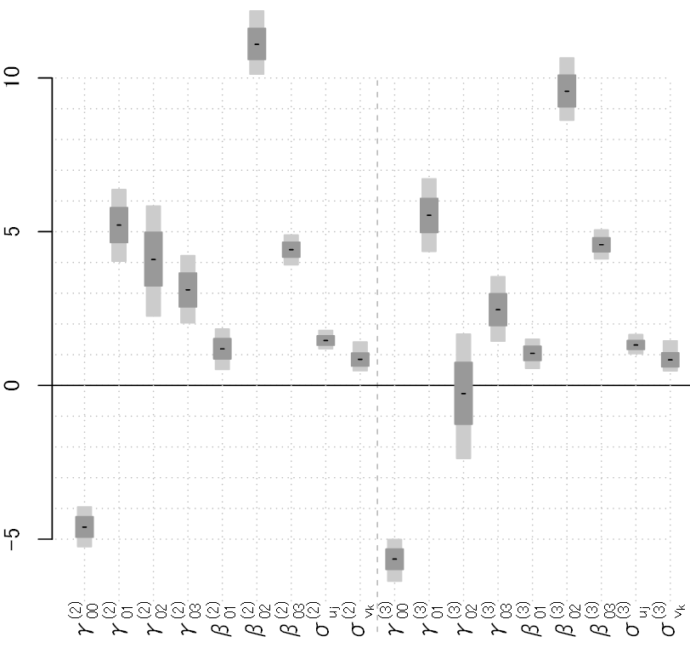
3 Results
Outline
Priors
Posteriors
Posteriors
(2) vs. nasar- (3) vs. o-…nasar-
$$β_{1}$$
(aux)
$$β_{2}$$
(imp_s)
$$η_{i\left(jk\right)}$$
$$β_{2}$$
(imp_w)
$$β_{0j}$$
$$γ_{1}$$
(origin)
$$γ_{2}$$
(mora)
$$γ_{0}$$
$$γ_{3}$$
(suppl)
(intercept)
$$u_{j}$$
(lexeme)
$$β_{0k}$$
$$v_{j}$$
(register)

Slide 13
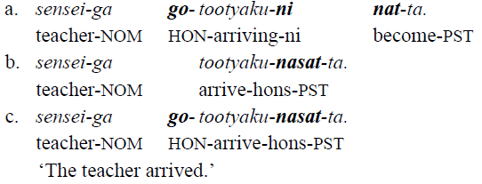
3 Results
Outline
Priors
Posteriors
Posteriors
(2) vs. nasar- (3) vs. o-…nasar-
$$β_{1}$$
(aux)
$$β_{2}$$
(imp_s)
$$η_{i\left(jk\right)}$$
$$β_{2}$$
(imp_w)
$$β_{0j}$$
$$γ_{1}$$
(origin)
$$γ_{2}$$
(mora)
$$γ_{0}$$
$$γ_{3}$$
(suppl)
(intercept)
$$u_{j}$$
(lexeme)
$$β_{0k}$$
$$v_{j}$$
(register)

Slide 14
3 Results
Outline
Priors
Posteriors
For Fixed Effects

Slide 15




3 Results
Outline
Priors
Posteriors
Interpretation
Group-level factors
(2) vs. nasar- (3) vs. o-…nasar-
$$β_{1}$$
(aux)
$$β_{2}$$
(imp_s)
$$η_{i\left(jk\right)}$$
$$β_{2}$$
(imp_w)
$$β_{0j}$$
$$γ_{1}$$
(origin)
$$γ_{2}$$
(mora)
$$γ_{0}$$
$$γ_{3}$$
(suppl)
(intercept)
$$u_{j}$$
(lexeme)
$$β_{0k}$$
$$v_{j}$$
(register)

Slide 16


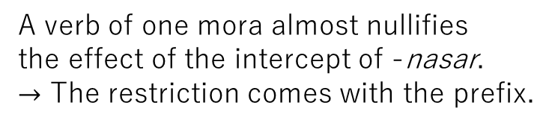
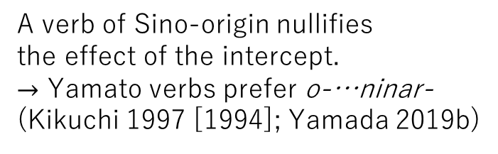

3 Results
Outline
Priors
Posteriors
Interpretation
Group-level factors
(2) vs. nasar- (3) vs. o-…nasar-
$$γ_{1}$$
(origin)
A verb of Sino-origin nullifies
the effect of the intercept.
$→$ Yamato verbs prefer o-…ninar-
(Kikuchi 1997 [1994]; Yamada 2019b)
$$γ_{2}$$
(mora)
A verb of one mora almost nullifies
the effect of the intercept of -nasar.
$→$ The restriction comes with the prefix.
$$γ_{3}$$
(suppl)
If a verb has a suppletive form,
(e.g., ik-, age-, iw-), Yamato verbs’
tendency of taking o…nar is attenuated.

Slide 17



3 Results
Outline
Priors
Posteriors
Interpretation
Population-level factors
(2) vs. nasar- (3) vs. o-…nasar-
$$β_{1}$$
(aux)
$$β_{2}$$
(imp_s)
$$η_{i\left(jk\right)}$$
$$β_{2}$$
(imp_w)
$$β_{0j}$$
$$γ_{1}$$
(origin)
$$γ_{2}$$
(mora)
$$γ_{0}$$
$$γ_{3}$$
(suppl)
(intercept)
$$u_{j}$$
(lexeme)
$$β_{0k}$$
$$v_{j}$$
(register)

Slide 18


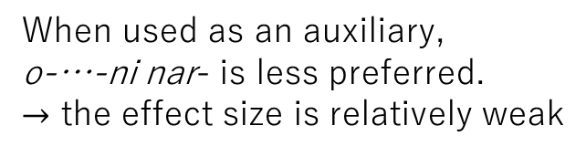

3 Results
Outline
Priors
Posteriors
Interpretation
Population-level factors
(2) vs. nasar- (3) vs. o-…nasar-
$$β_{1}$$
(aux)
When used as an auxiliary,
o-…-ni nar- is less preferred.
$→$ the effect size is relatively weak
$$β_{2}$$
(strong imperative)
When used in a strong imperative ,
o-…-ni nar- is strongly avoided.
$$β_{3}$$
(weak imperative)
When used in a strong imperative ,
o-…-ni nar- is avoided.
Interaction with speech act
assignments (Yamada 2019a)

Slide 19
3 Results
Outline
Priors
Posteriors
For Random Effects

Slide 20
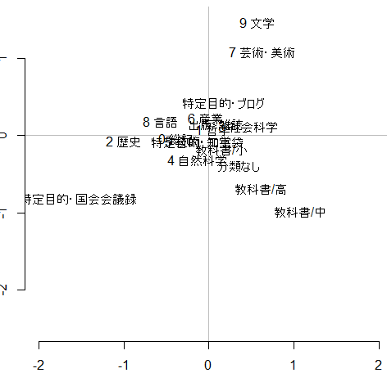
3 Results
Outline
Priors
Posteriors
Interpretation
Residuals: among registers
o-…nasar-
(9 Literature)
(7 Arts)
Literature/arts
to be examined
(Hyp 1) Orientation to the
ancient literature
nasar-
Textbooks
to be examined
(Hyp2) Fixed expressions,
emergent in textbooks
White Papers
Diets
to be examined
(Hyp3) Prescriptivism/siteki
Textbooks
(high school/
middle school)

Slide 21
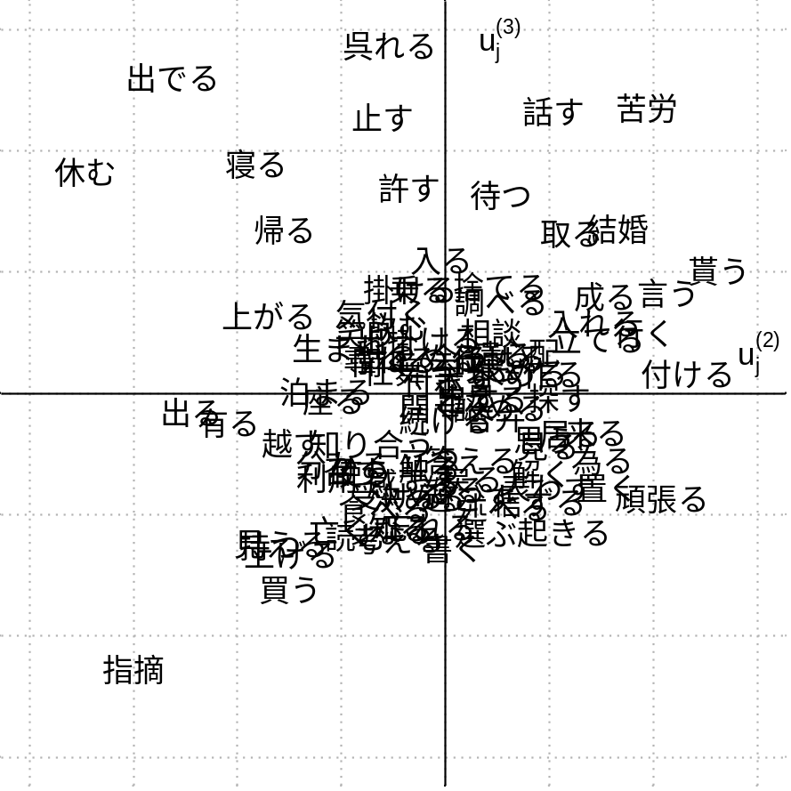
3 Results
Outline
Priors
Posteriors
Interpretation
Residuals: among lexemes
o-…nasar-
de- ‘come out’
A clear counterexample to
the mora restriction
(Hyp 4) Etymology/phonology
ide
kuro
yasum
nasar-
Prefix and idiomaticity
(Hyp 5) The prefix is the source
of the semantic opacity;
e.g., oidenasaru, oyasuminasar
de
Variation among Sino verbs
to be examined
siteki

Slide 22
4 Conclusions & Implications

Slide 23
3 Results
Outline
Previous studies
This study
Qualitative studies
Quantitative studies
Idiosyncrasies/detailed patterns
General tendencies
a. One-mora restriction
a. Counterexample: de- ‘come out’
b. Yamato verbs
-> o-…ni nar-
b. Variation among Sino verbs
-> kuro vs. siteki

